Slide 1
Towards a Safe System Approach to Prevent Health Loss among Motorcyclists
The importance of Motorcycle Stability as a Condition for Integrated Safety

Slide 2
The integrated chain of events
Normal driving
Deviation from normal driving
Emerging situation
Critical situation
Crash unavoidable
Emergency services and health care
Crash

Slide 3
The integrated chain of events
Normal driving
Deviation from normal driving
Emerging situation
Critical situation
Crash unavoidable
Emergency services and health care
Crash
What a nice ride on a Sunday morning!
The car in the front is getting closer…
Oops why is my back wheel locked?
You get distracted
This may hurt...
Crash protection
Prompt rescue
Rehabilitation

Slide 4
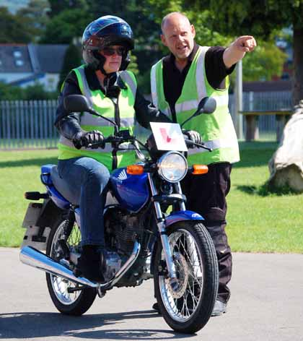
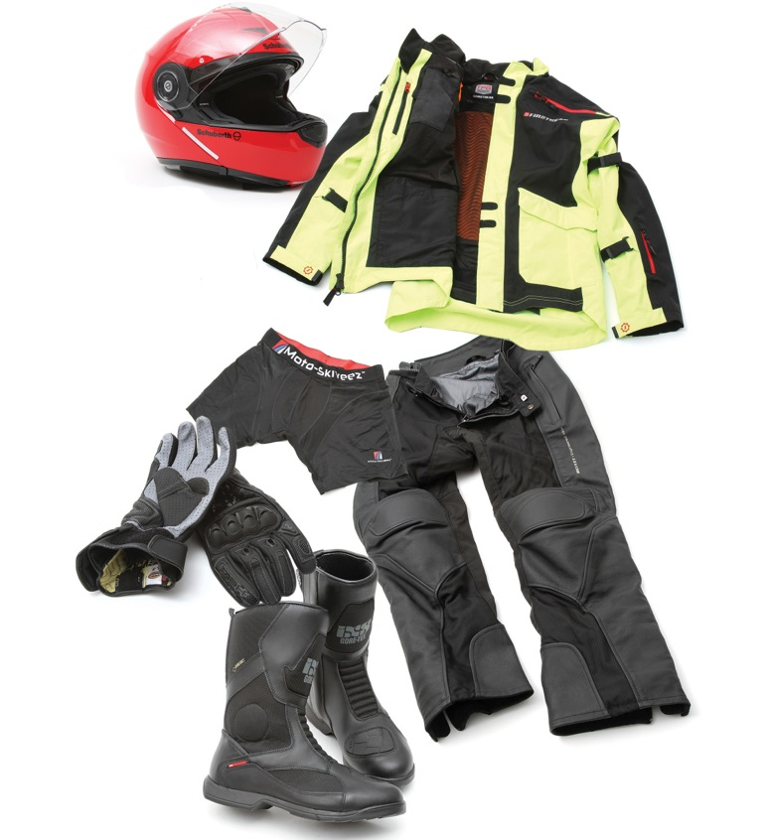
The traditional approach to motorcycle safety
Normal driving
Deviation from normal driving
Emerging situation
Critical situation
Crash unavoidable
Crash

Slide 5

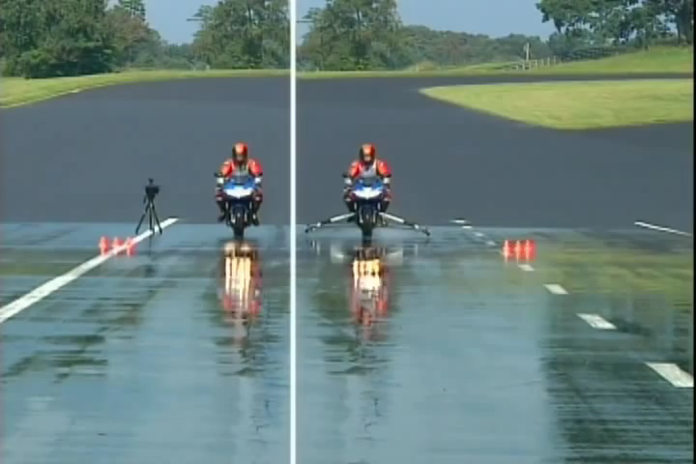
Antilock Brakes on motorcycles

Slide 6
Overall aim of this research
Understand the chain of events leading to crashes with ABS motorcycles, compared to similar motorcycles without ABS
Normal driving
Deviation from normal driving
Emerging situation
Critical situation
Crash unavoidable
Crash

Slide 7
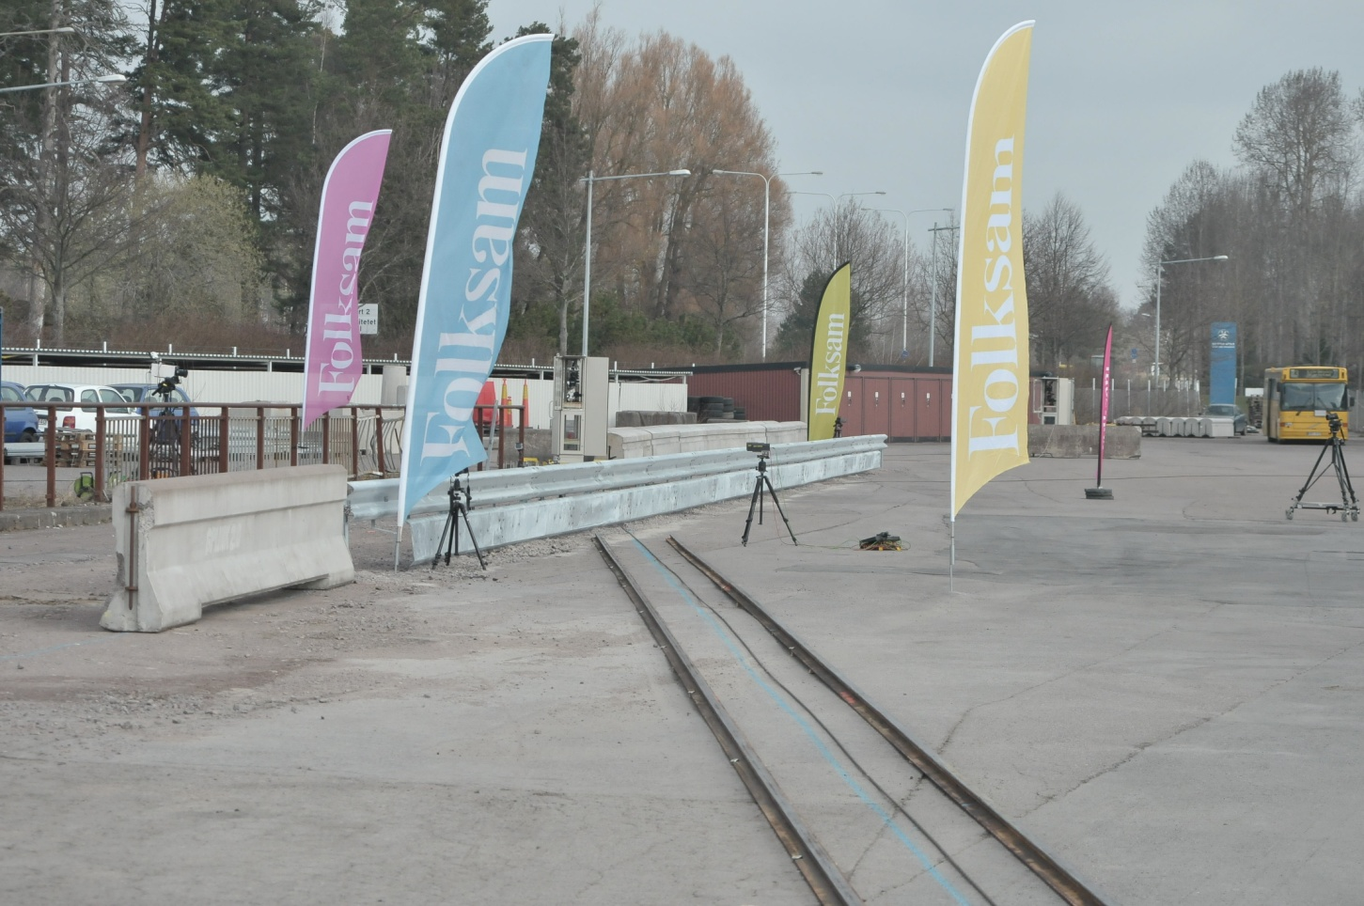
Crash tests
60 km/h with 10°impact angle
Hybrid III dummy fitted with protective gear
4 combinations motorcycle / W-beam barrier
x

Slide 9
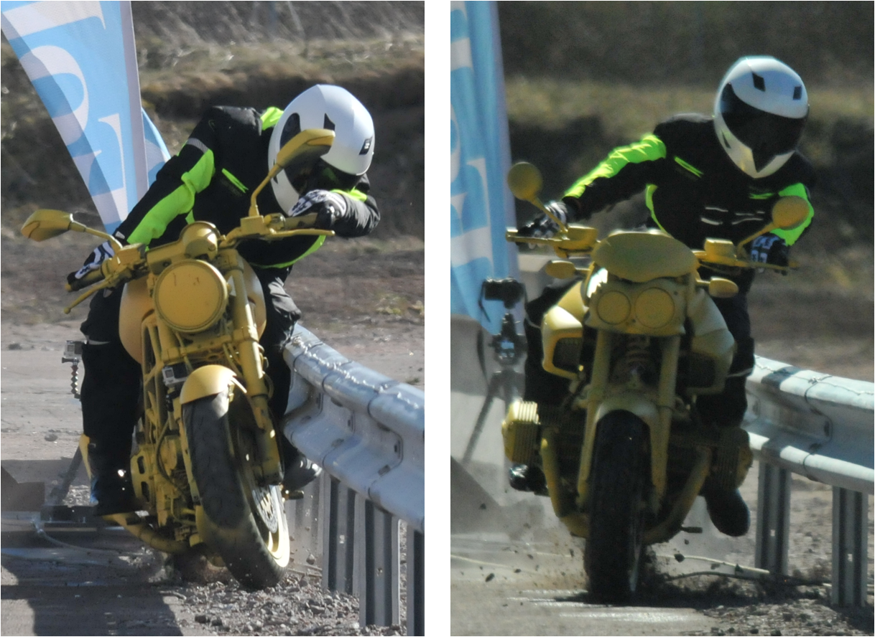

Slide 10
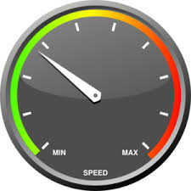


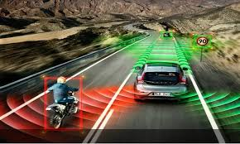
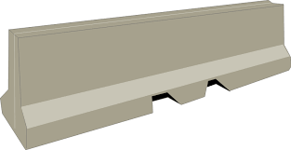

Ett säkert system baseras på en stabil MC
Normal driving
Deviation from normal driving
Emerging situation
Upright crash
ESC
mc
!
Auto broms
DoU
AIR
BAG

Slide 11
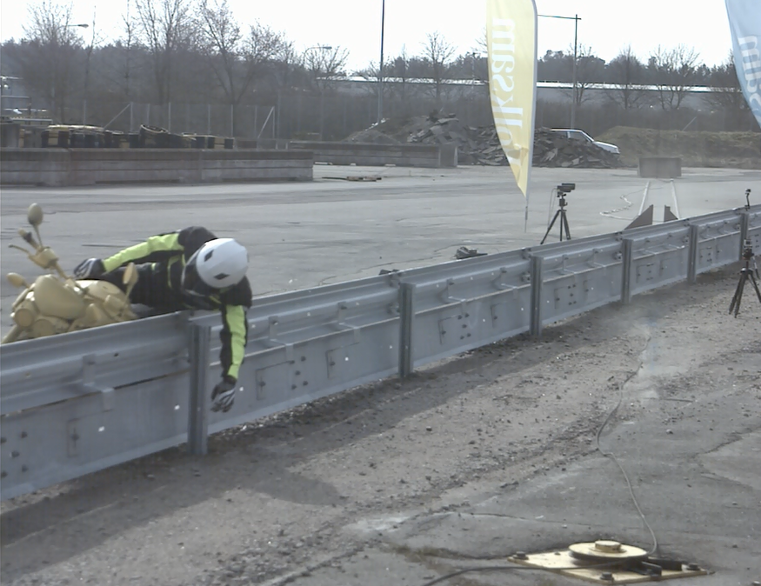

Slide 12
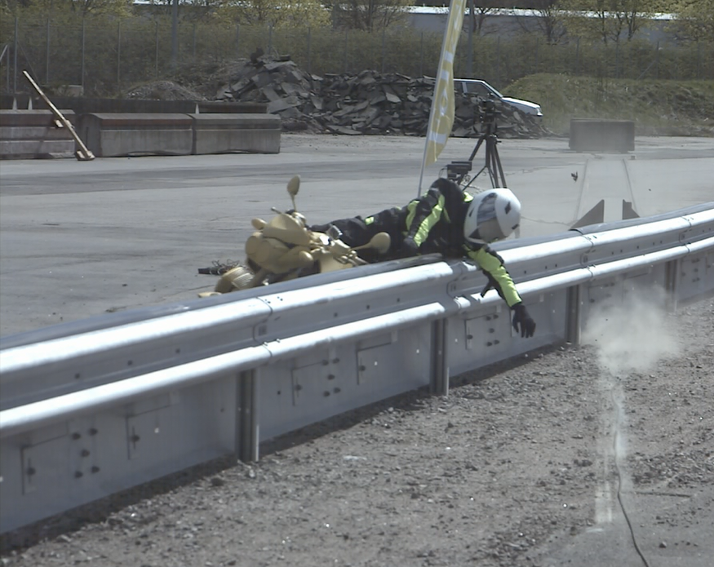

Slide 13
Motorcycle development
Head and thorax airbag
Honda Goldwing
Leg airbag and crash stabiliser
Needs to be developed
Motorcycle Autonomous Emergency Braking
Under development
Double front wheels
Piaggio MP3
ABS, Linked Brakes, Traction Control

Slide 14
Conclusions
ABS prevents crashes in the first place, but also increases stability and makes crashes that do occur more predictable
Greater focus on upright crashes (road barriers)
Motorcycle design more important
New possibilities for crash protection

Slide 15

Thank you for your attention!
matteo.rizzi@folksam.se
070 831 61 19

